Slide 1

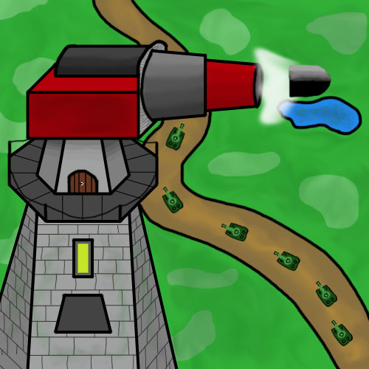
Tower
Defense
The Next Generation

Slide 2
Content
Project Overview
Vision
Technology
Project Management
Architecture
Game Engine
Demo
Project Overview | Architecture | Game Engine | Demo | End

Slide 3
Project Overview
Project Overview | Architecture | Game Engine | Demo | End

Slide 4
The Project Vision
Define Analyse Implement Review Publish Maintain
self-developed engine
multiple-level support
customization of
designs
effects
RUP terminology used
PM using Scrum and Jira
technology according to current standards
unique game-concept
creation of a community
potential for high user amount after months
Project Overview | Architecture | Game Engine | Demo | End

Slide 5





Technology
Android Studio
XML / Java
Gimp /
Photoshop Elements 2018
Project Overview | Architecture | Game Engine | Demo | End
Notes:
Sources:
Android Studio Logo: https://www.pngfans.com/middle-27e90f5a7f152dfd-svg-android-studio-logo.html
XML Logo: https://miro.medium.com/max/672/1*SIYdOHTFuTgAylnH_MXHtg.png
Java Logo: https://upload.wikimedia.org/wikipedia/de/thumb/e/e1/Java-Logo.svg/2000px-Java-Logo.svg.png
Gimp Logo: https://upload.wikimedia.org/wikipedia/commons/thumb/4/45/The_GIMP_icon_-_gnome.svg/2000px-The_GIMP_icon_-_gnome.svg.png
Photoshop Elements Logo: https://www.zdnet.de/wp-content/uploads/2014/09/ps_elements_13-logo.jpg

Slide 6

Scrumming on Jira
PLAN, TRACK, REPORT
Jira is one of the most often used tool for agile project-management purposes. Due to its simple way of planning, tracking and reporting, Jira provides a great scope of functions.
ITERATIVE PROCESS
Especially, external conditions in the development-environment can change very quickly. Therefore, working iteratively is one of the most important aspects while developing.
TIME-TRACKING
In times of efficiency, there is a need of time-tracking in order to optimize several processes.
CUSTOMIZATION
Jira supports more than 3000 additional plugins to adapt to specific needs. On top, this provides the ability to live Scrum after own adjustments.
Project Overview | Architecture | Game Engine | Demo | End

Slide 7
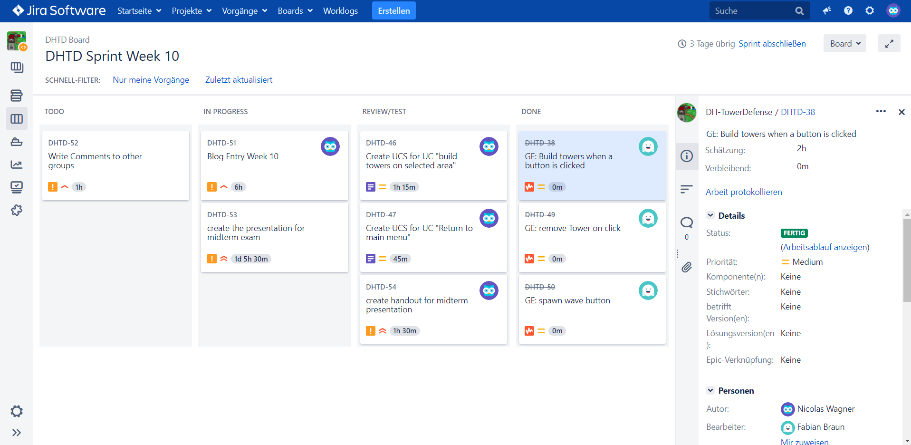
Jira
Project Overview | Architecture | Game Engine | Demo | End
Notes:
Source:
Jira: http://jira.dh-towerdefense.de/secure/Dashboard.jspa

Slide 8



OUR TEAM
Fabian Braun
Luca Rutschmann
Nicolas Wagner
Scrum Master
Software Architect
Implementer (Game Engine)
Implementer (Game Engine)
Tester/Reviewer
Project Manager
Implementer (Surface/Overlay)
With a lot of experience in developing several applications, Fabian knows which aspects are the most important ones to focus on.
Testing developed code is an activity that Luca loves to do in every project.
Good project-management can improve its success by a lot. Nicolas considers PM as the most significant task in a project.
Project Overview | Architecture | Game Engine | Demo | End

Slide 9
Architecture
Project Overview | Architecture | Game Engine | Demo | End

Slide 10
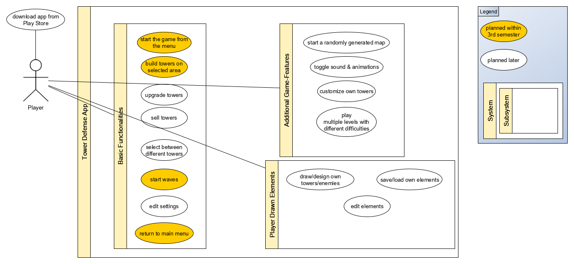
Use Case
Diagram
Project Overview | Architecture | Game Engine | Demo | End

Slide 11
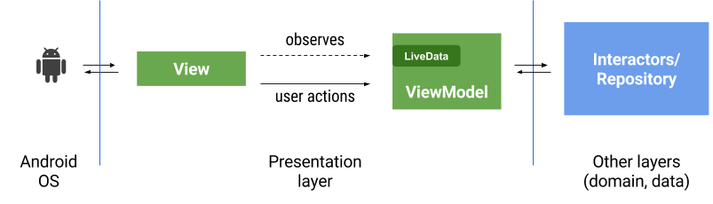
Android MVC
Project Overview | Architecture | Game Engine | Demo | End

Slide 12
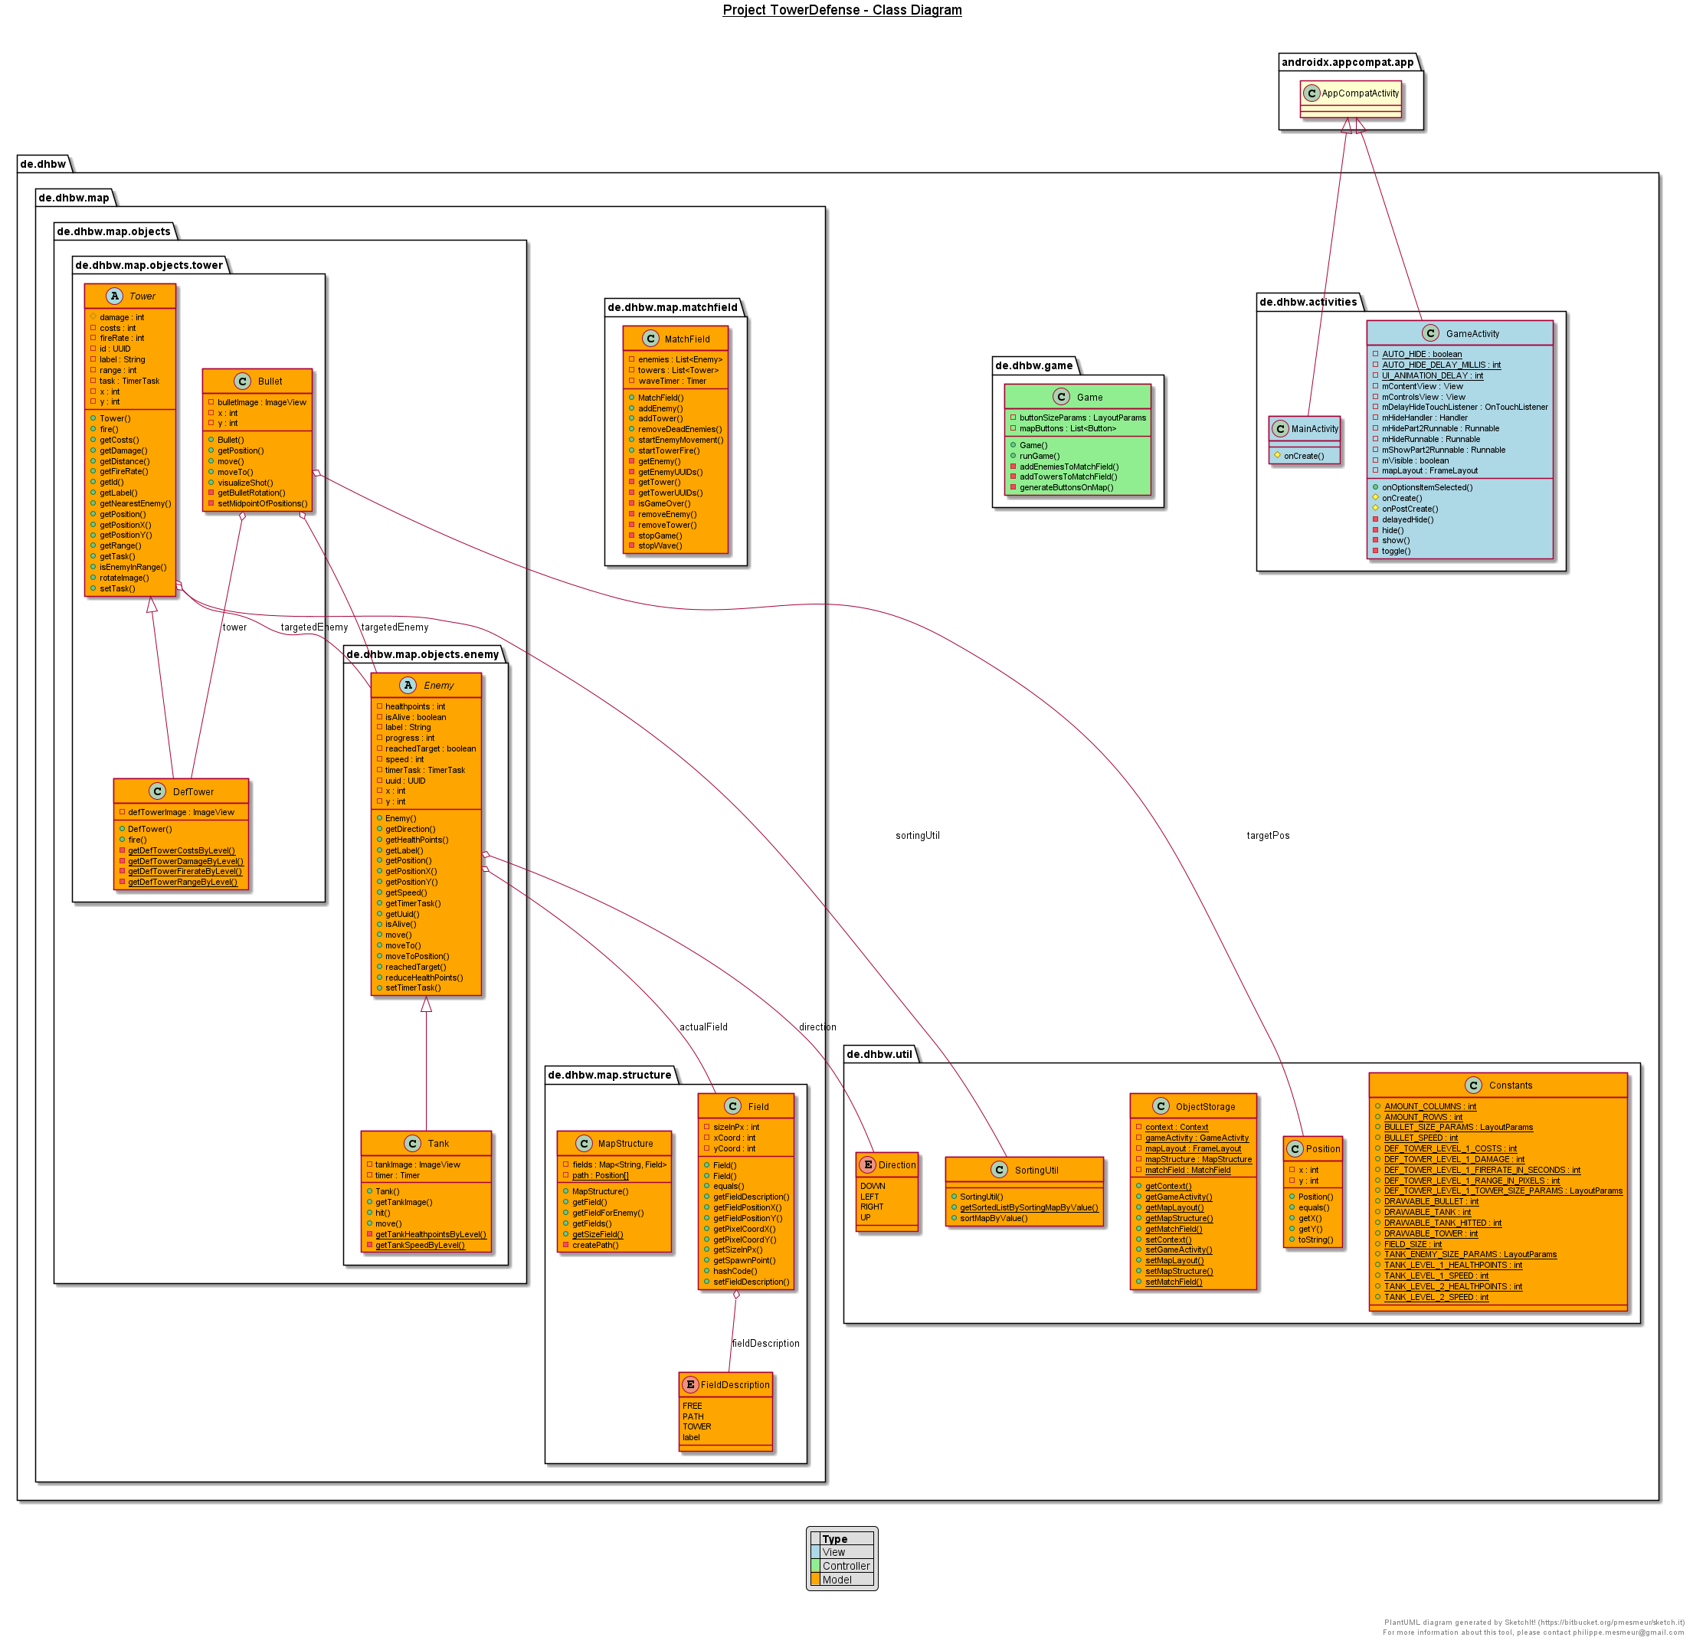
Project MVC
Project Overview | Architecture | Game Engine | Demo | End

Slide 13


Automation
Commits
Tasks
Code
Project Overview | Architecture | Game Engine | Demo | End
Notes:
Sources: Jira Logo: https://www.atlassian.com/de/software/jira
Android Studio Logo: https://www.pngfans.com/middle-27e90f5a7f152dfd-svg-android-studio-logo.html
Git Logo: https://git-scm.com/images/logos/downloads/Git-Icon-1788C.png

Slide 14
Game Engine
Project Overview | Architecture | Game Engine | Demo | End

Slide 15
Structure
MainActivity
GameActivity
Game
Enemy
MatchField
Tower
Tank
DefTower
MapStructure
Field
Bullet
Project Overview | Architecture | Game Engine | Demo | End

Slide 16
Components
User Interface | Game-Logic
Activities | Abstract Classes (attributes)
ImageViews | Controller Classes (logical actions)
Buttons | Timer/Threads, Streams
Project Overview | Architecture | Game Engine | Demo | End

Slide 17


Testing
UI testing with Cucumber
Feature Files executed with Espresso & GreenCoffee
Logical testing with JUnit
testing of calculations, operations and more
Project Overview | Architecture | Game Engine | Demo | End
Notes:
Sources:
Junit Logo: https://junit.org/junit4/images/junit5-banner.png
Cucumber Logo: https://lisacrispin.com/wp-content/uploads/2019/01/Screen-Shot-2019-01-17-at-12.13.33-PM.png

Slide 18

DEMO
Project Overview | Architecture | Game Engine | Demo | End

Slide 19

Time Sheet
The numbers and data of the charts are automatically tracked by Jira which enables a detailed evaluation of the work done so far.
Project Overview | Architecture | Game Engine | Demo | End

Slide 20
Time Sheet
The numbers and data of the charts are automatically tracked by Jira which enables a detailed evaluation of the work done so far.
Project Overview | Architecture | Game Engine | Demo | End

Slide 21
THANK
YOU
If You would like to create and work with us, please contact us using the mail addresses below.
Fabian Braun
fabian.braun@dh-towerdefense.de
Luca Rutschmann
luca.rutschmann@dh-towerdefense.de
Nicolas Wagner
nicolas.wagner@dh-towerdefense.de
Project Overview | Architecture | Game Engine | Demo | End

